Slide 1
MedTrack_DV (Hospital Operations & Patient Analytics Dashboard)
Hospital Overview

Slide 2
Problem Statement :-
This project aims to develop a comprehensive hospital operations and patient analytics dashboard suite for analyzing hospital performance, patient admissions, department efficiency, and healthcare resource utilization.
The final deliverable is a unified Tableau workbook consisting of four interconnected dashboards:
Hospital Overview
Patient Flow
Department Analytics
Resource Utilization

Slide 3
Milestone 1:-
Datasets Used (HMIS, Hospital Beds, Readmission, Inpatient Discharges)
Data Profiling
Data Cleaning & Standardization (IDs, Departments, Dates)
Missing Values & Duplicate Handling
Final Tables (Hospital Overview, Patient Flow, Department Analytics, Resource Utilization)
Validation

Slide 4
Milestone 2:-
KPI Calculation
Total Admissions
Occupancy Rate
Average Length of Stay
Readmission Rate
Bed Utilization Rate
Department Efficiency Score
KPI Documentation : Formula, Definition, Data Source, Interpretation
Dashboard Storyboard : Purpose → KPIs → Charts → Filters → Interactions
Tableau Data Model
Initial Dashboard Prototype

Slide 5
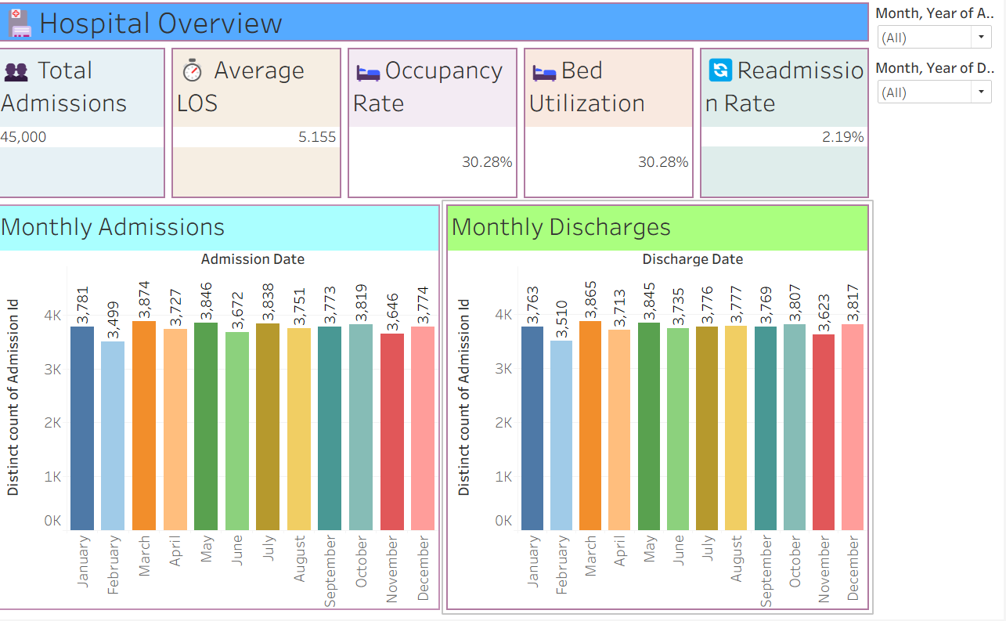
Milestone 3:-
Hospital Overview Dashboard:-

Slide 6
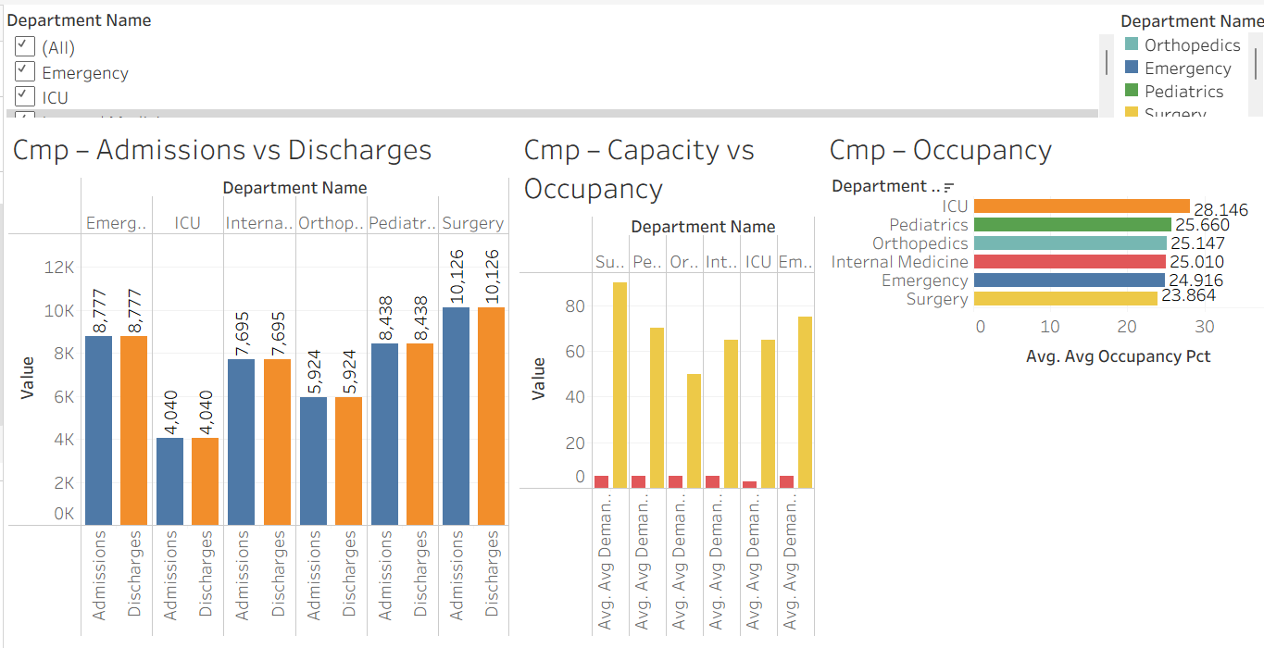
Department Analytics Dashboard:-

Slide 7
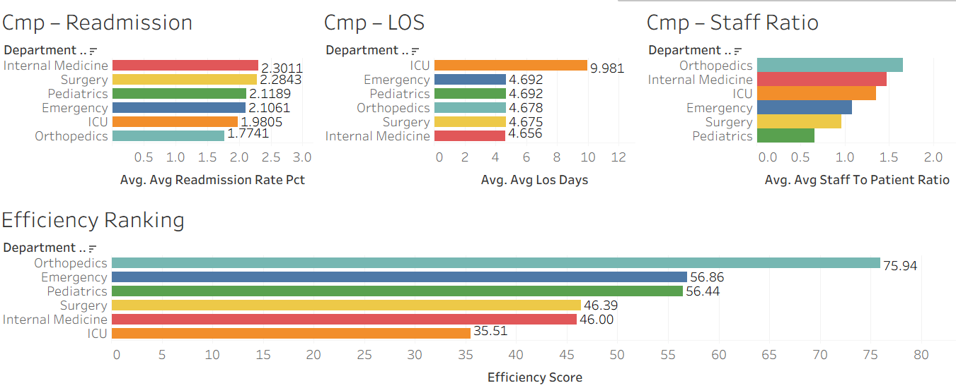

Slide 8
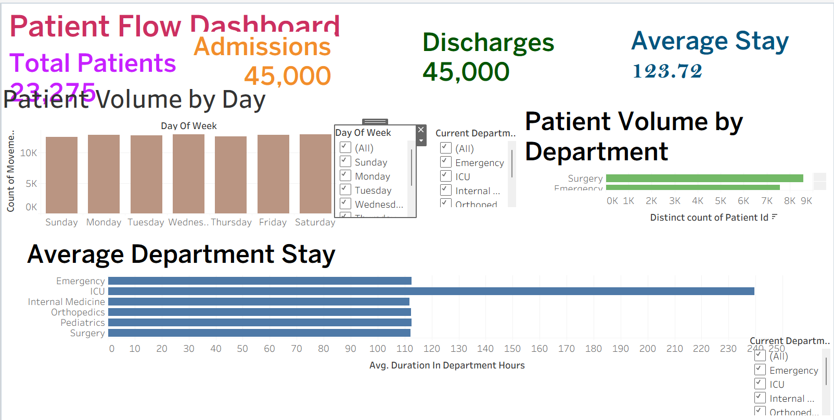
Patient Flow Dashboard:-

Slide 9
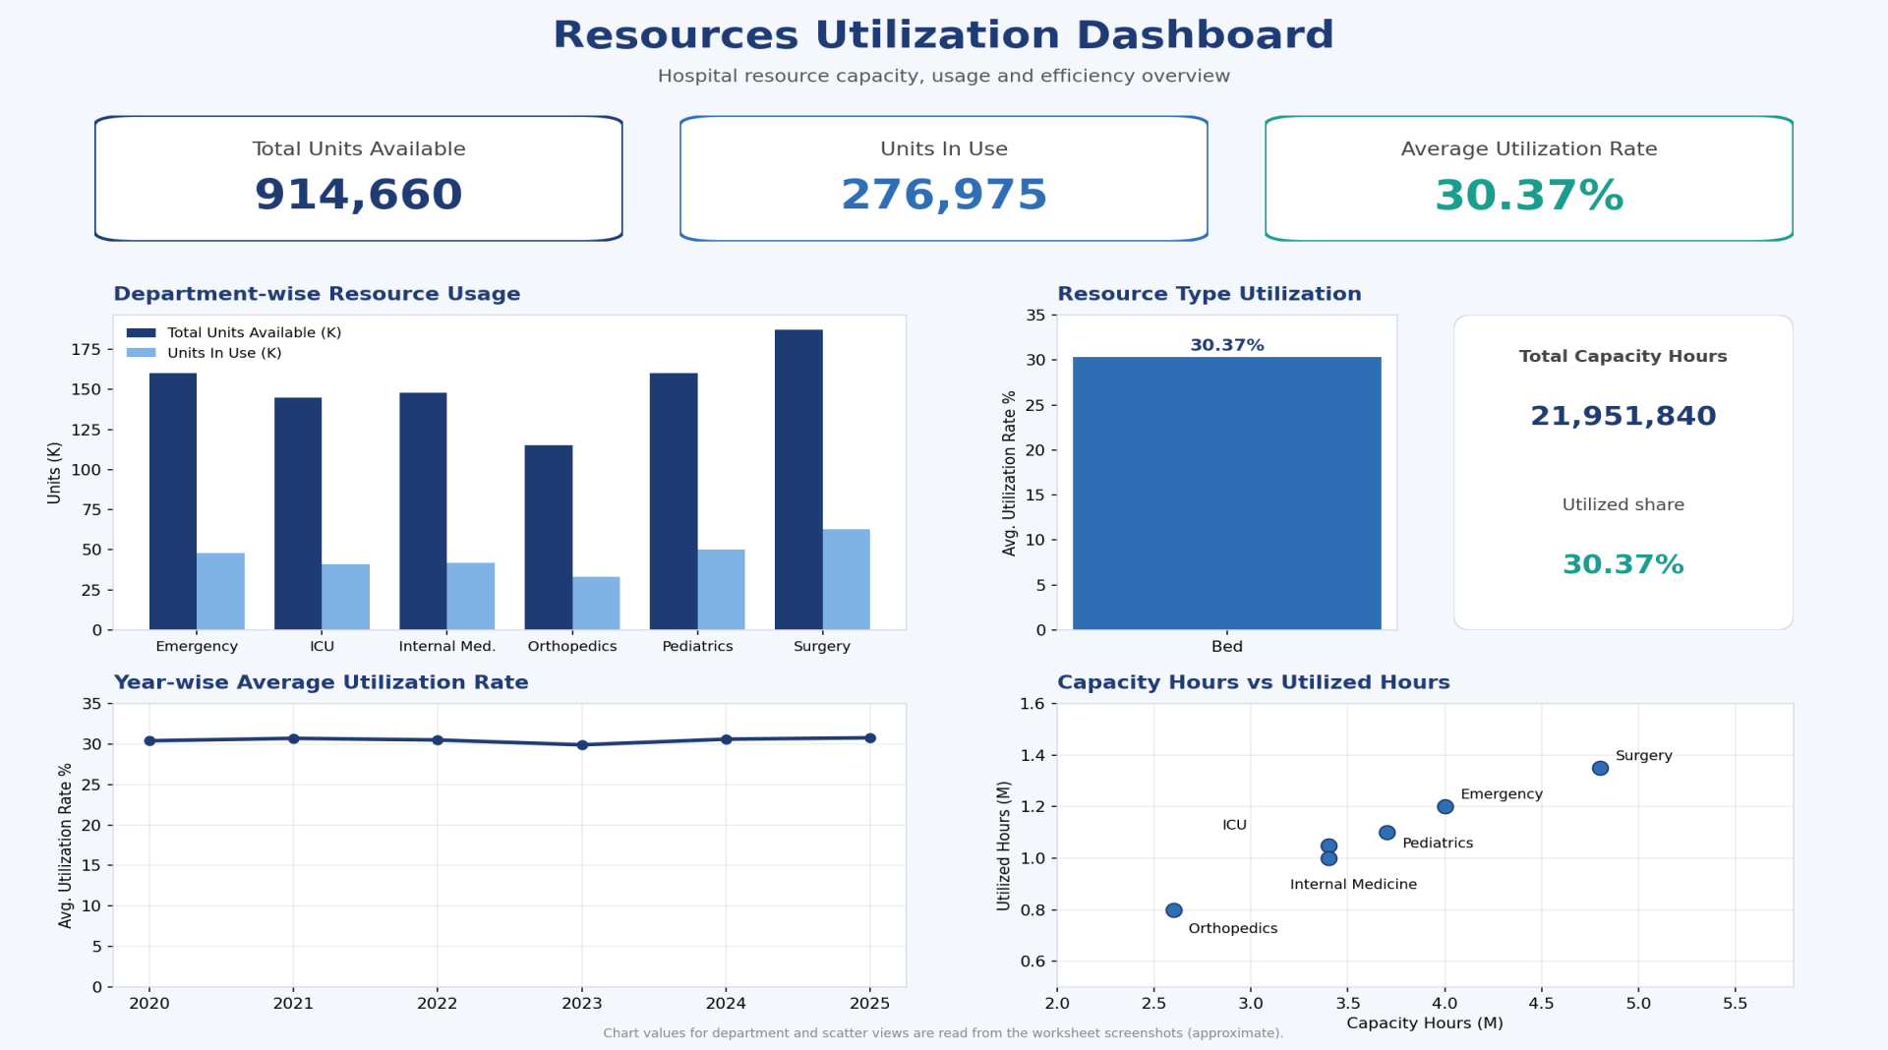
Resource Utilization Dashboard:-

Slide 10
Milestone 4:-
Dashboard Testing
Hospital Overview Dashboard
Patient Flow Dashboard
Department Analytics Dashboard
Resource Utilization Dashboard
Dashboard Checks: KPIs, Filters, Navigation/Actions, Consistency
Data Testing, Part 1 : Row Counts, Missing/Null Values, Duplicate Checks
Data Testing, Part 2 : Primary Keys, Foreign Keys, Relationship Matching
KPI Testing : Verifying the 6 Mandatory KPIs with Python/Pandas

Slide 11
Conclusion:-
Raw hospital data was cleaned, standardized and made analysis-ready.
Key KPIs were defined, documented and verified.
Four interactive Tableau dashboards were built: Hospital Overview, Patient Flow, Department Analytics and Resource Utilization.
Data and dashboards were tested for accuracy, consistency and working filters.
Resource usage shows an average utilization rate of 30.37%, so there is room for better bed and resource planning.
Hospital management can use the dashboards to make faster, data-driven decisions.
Future scope: real-time data and predictive analytics.

Slide 12
Tableau Links:-
https://public.tableau.com/app/profile/suhitha.paidi/viz/Hospital_Overview_Dashboard3/HospitalOverview?publish=yes
resource_utilization_dashboard1 | Tableau Public
public.tableau.com/app/profile/suhitha.paidi/viz/Departmentdashboard_17913770908060/CmpAdmissionsvsDischarges?publish=yes
Patient flow dashboard MILESTONE 3 new | Tableau Public

Slide 13
Team Members:-
Suhitha
Shika
Divya Sree
Kavya
Jayanth kumar
Devansh
Shivam Rawat

Slide 14
Thank you

